Slide 1



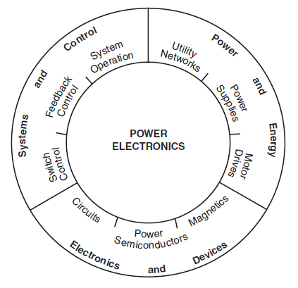
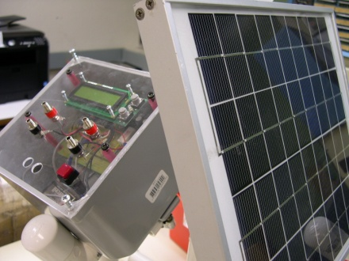
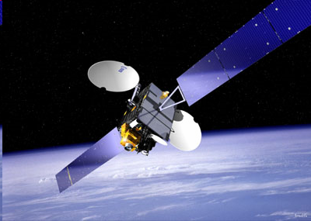
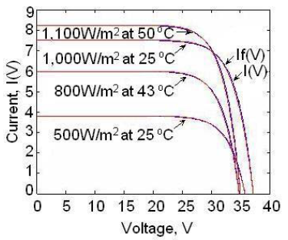
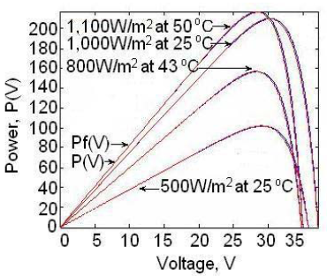
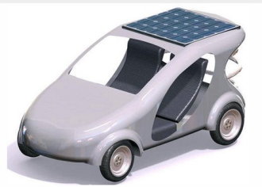
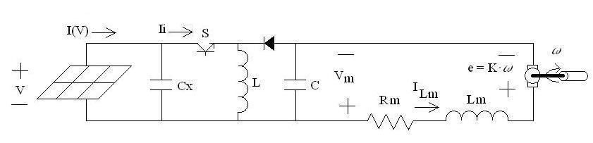
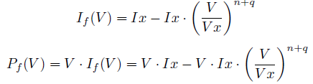

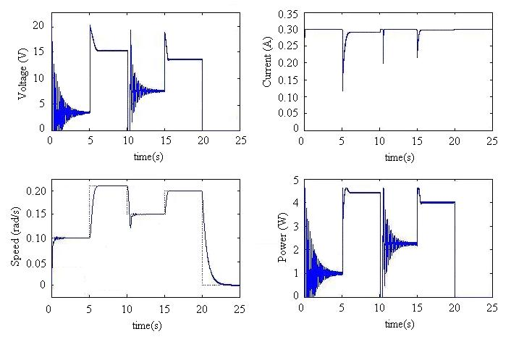
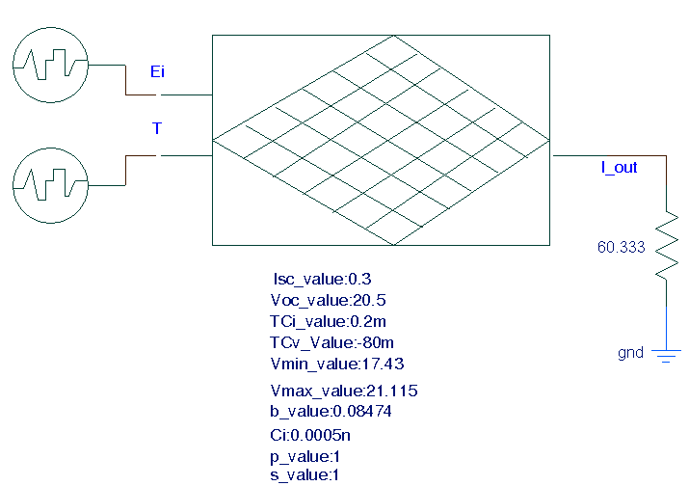
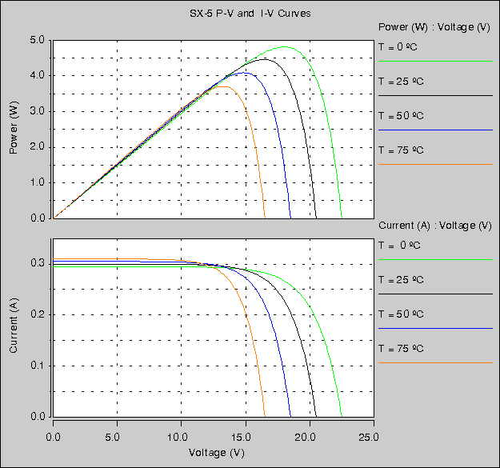
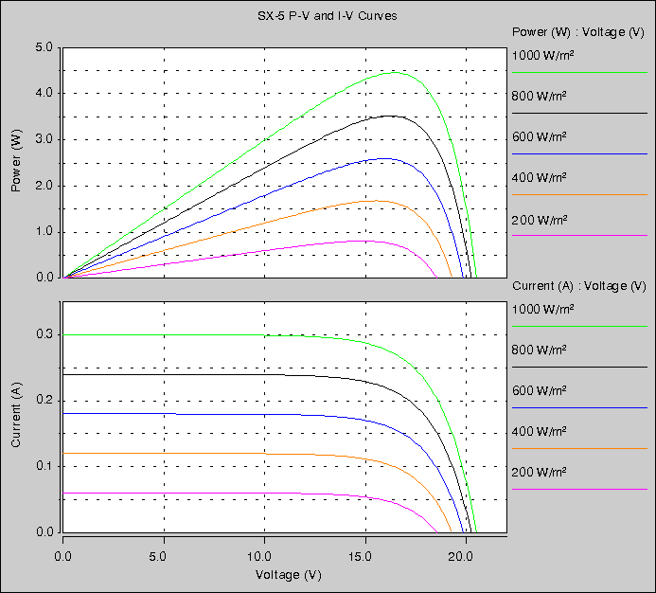
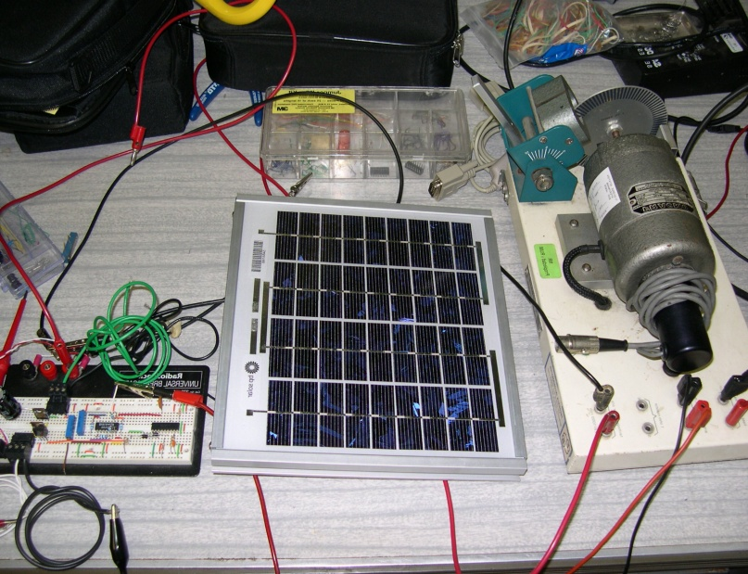
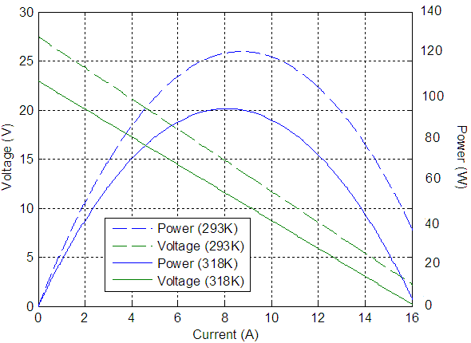
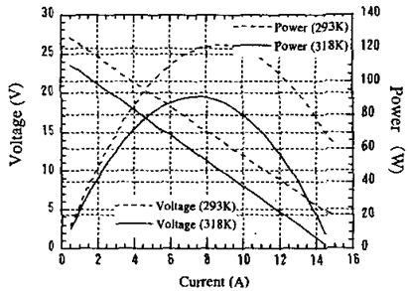
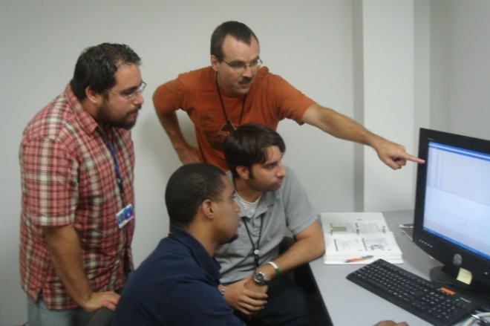
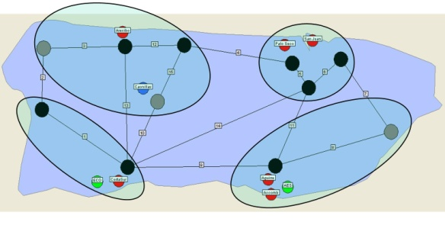
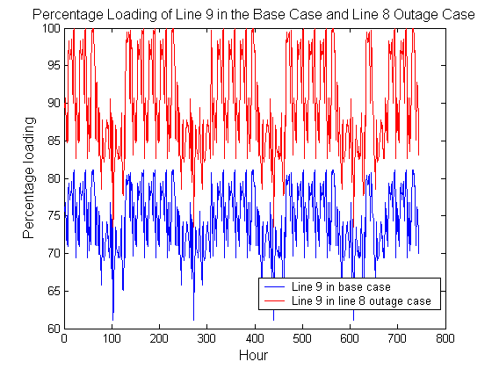

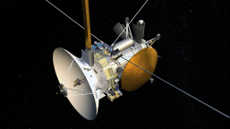
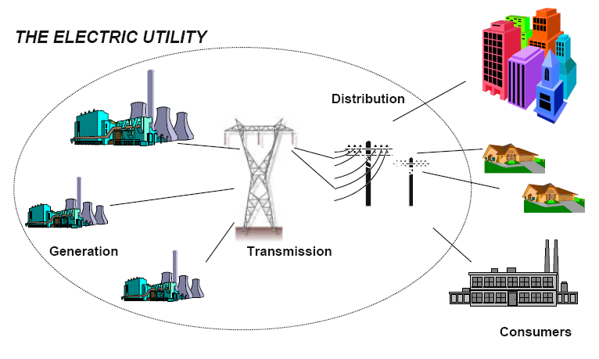
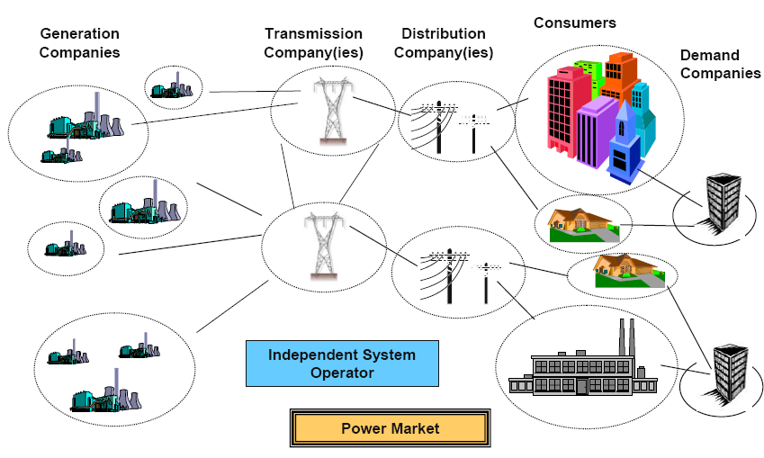
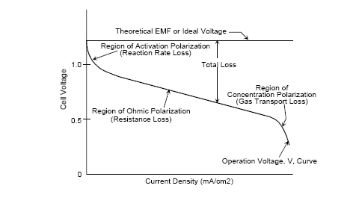





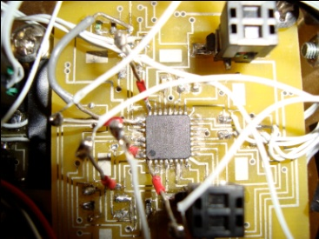
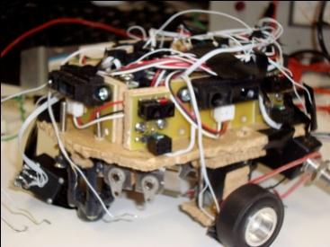


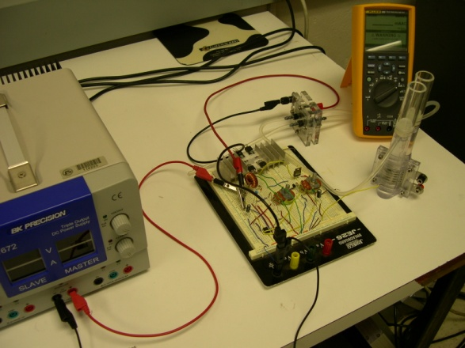
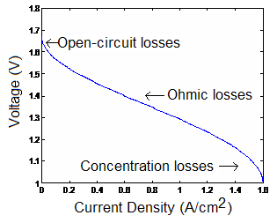
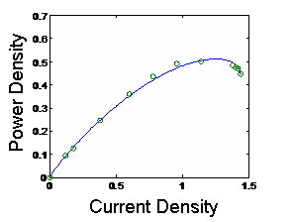




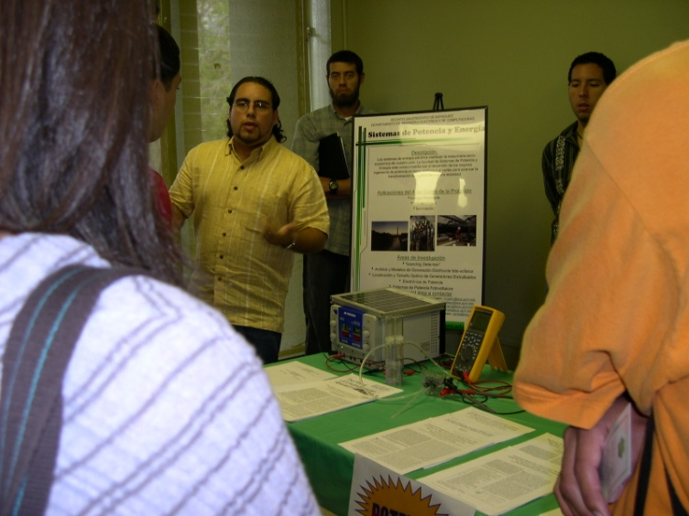
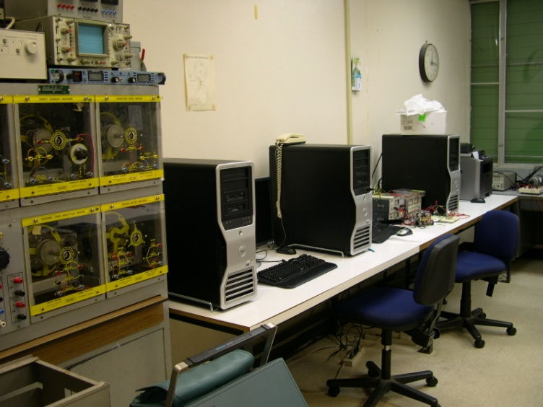
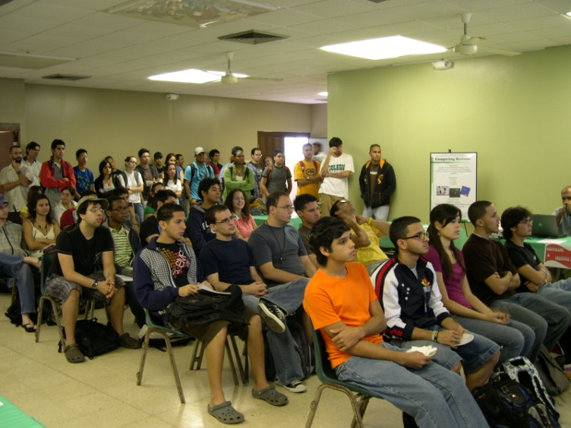
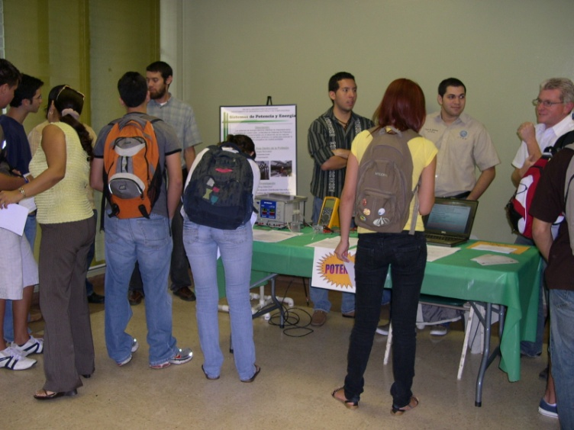
S101: Power Electronics & Renewable Energy Laboratory
M_{inds}²CREATE Undergraduate Research & Education
Dr. Eduardo I. Ortiz-Rivera
Department of Electrical and Computer Engineering
University of Puerto Rico, Mayaguez 00681
Purpose of S101
Emulate Photovoltaic Modules
Application: Solar Car
Awards for works done at S101
The Power Electronics and Renewable Energy Laboratory at UPRM is the only undergraduate research & educational laboratory focused on modeling, design, control, and implementation of power electronic interfaces for renewable energy applications. S101 serves several undergraduate and graduate courses related to power electronics. S101 has three phase and single phase sources, PV modules, fuel cells, electric drives, etc. Also, S101 offers the opportunity to undergraduate students to do research on power electronics in partnership with several programs like NSF-ERC CPES, GM-PACE Program, IAP, NSF-REU, etc.
Right now, Dr. Eduardo I. Ortiz-Rivera is in charge of S101. He is the only UPRM’s faculty member certified by NABCEP on photovoltaic systems, his Ph.D. is the modeling, control and analysis of photovoltaic power systems, with more than 30 publications in the areas of power electronics, renewable energy, and engineering education.
Luisa Feliciano – IEEE IAS Myron Zucker Student Paper Award (2009)
Andres Salazar – IEEE PMSA Student Travel Award (2009)
Jesus Gonzalez – IEEE IES Electric Drives Travel Award (2009)
Daniel Soltero – IEEE Best Paper Award (Int. Conf . Robotics)(2009)
Omar Gil Arias – IEEE Emerald-COMPEL Student Award (2008)
Miguel Rios – IAP First Place Undergraduate Research (2007, 2008)
Jorge Cintron – NSF Fellowship and GEM Fellow (PhD. Studies MSU)
Estimated vs measured results for a PVM SLK60M6
Solar Car: PVM connected to a BBC and a dc motor.
Publications Produced at S101
(During the last 3 years )
PVM Electrical Model
Modeling & Emulation of the behavior of a PVM in SABER.
Thermoelectric Generators
Experimental set-up.
Results for speed tracking control.
1. Ortiz-Rivera, Eduardo I.; Cosme, Antonio; Alvarez, Jaime; “Compact Fluorescent Lamps, an Anticipatory Mind to Mercury” IEEE Potentials-Magazine March/April. 2010 Vol.29 No.2
2. Jimenez-Brea, Emil A.; Ortiz-Rivera, Eduardo I.; "Simple Photovoltaic Solar Cell Dynamic Sliding Mode Controlled Maximum Power Point Tracker for Battery Charging Applications" 23rd IEEE Applied Power Electronics Conf. and Expo, Palms Springs, CA, Feb. 21-25, 2010
3. Ortiz-Rivera, Eduardo I.; "A Mathematical Model for Online Electrical Characterization of Thermoelectric Generators Using the P-I Curves at Different Temperatures" 23rd IEEE Applied Power Electronics Conference and Exposition, Palms Springs, CA, February 21-25, 2010
4. Jimenez-Brea, Emil A.; Ortiz-Rivera, Eduardo I.; “A Maximum Power Point Tracker Implementation for Photovoltaic Cells Using Dynamic Optimal Voltage Tracking" 23rd IEEE Applied Power Electronics Conference and Exp., Palms Springs, CA, February 21-25, 2010
5. Gonzalez, Jesús; Ortiz-Rivera, Eduardo I.; "Analyzing the Optimal Matching of DC Motors to Photovoltaic Modules via DC-DC Converters" 23rd IEEE Applied Power Electronics Conference and Exp., Palms Springs, CA, February 21-25, 2010
6. Ortiz-Rivera, Eduardo I.; Salazar, Andres C.; Velez, José; “An Enriched Undergraduate Research Experience based on the Simulation, Experiments, and Theory of Fuel Cells” 2009 Frontiers in Education Conference, San Antonio, TX , October 18-21, 2009
7. Ortiz-Rivera, Eduardo I.; Castro, Marcel; “Integration of Hands on Laboratory Experience of Power Electronics and Renewable Energy Applications: Work in Progress” 2009 Frontiers in Education Conference, San Antonio, TX, October 18-21, 2009
8. Ortiz-Rivera, Eduardo I.; Gonzalez, Jesús; Salazar, Andres C.; “Bringing Renewable Energy to the Electrical Engineering Undergraduate Education & Research at UPRM” 2009 Frontiers in Education Conference, San Antonio, TX, October 18-21, 2009
9. Ortiz-Rivera, Eduardo I.; Feliciano, Luisa; “Performance Evaluation and Simulation of a Solar Thermal Power Plant” 2009 IEEE Energy Conversion Congress and Exposition (Former IEEE PESC Conference), San Jose, California, USA, Sept. 20-24, 2009 (IEEE Student Award!)
10. Diaz, Andrés J.; Ortiz-Rivera, Eduardo I.; Saltares, Roger; Rodríguez, Christian; Nuñez, Roberto; “Three Phase Induction Motor Equivalent Circuit for Dynamic Simulation” IEEE International Machines and Drives Conference, Miami, FL, May 3-6, 2009
11. E. E. Jimenez-Toribio, A. A. Labour-Castro, F. Muniz-Rodriguez, H. R. Perez-Hernandez, and E. I. Ortiz-Rivera; “Sensorless Control of SEPIC and Cuk Converters for DC Motors using Solar Panels” IEEE International Machines and Drives Conference, May 3-6, 2009
12. Gonzalez-Llorente, Jesús; Ortiz-Rivera, Eduardo I.; Diaz, Andrés J.; “A Maximum Power Point Tracker using Positive Feedforward Control based on the DC Motor Dynamics and PVM Mathematical Model” IEEE International Machines and Drives Conference, May 3-6, 2009
13. Balaguer, Irvin J.; Kim, Heung-Geun; Peng, Fang Z.; Ortiz, Eduardo I.; “Survey of Photovoltaic Power Systems Islanding Detection Methods” 34th Annual Conference of the IEEE Industrial Electronics Society, November 10-13, 2008
14. Ortiz-Rivera, Eduardo I.; Diaz, Andrés J.; “An Approximation of a PVM Model using Integer Polynomials” 34th Annual Conf. of the IEEE Ind. Electronics Soc., Nov. 10-13, 2008
15. Jimenez-Brea, Emil A.; Ortiz-Rivera, Eduardo I.; “A Dynamic Maximum Power Point Tracker using Sliding Mode Control for Photovoltaic Applications” 11th IEEE Control and Modeling for Power Electronics (COMPEL), Zurich, Switzerland, August 18-20, 2008
16. Gil-Arias, Omar; Ortiz-Rivera, Eduardo I.; “A General Purpose Tool for Simulating the Behavior of PV Solar Cells, Modules and Arrays” 11th IEEE Control and Modeling for Power Electronics (COMPEL), Zurich, Switzerland, August 18-20, 2008
17. Ortiz-Rivera, Eduardo I.; Pan, Zach; Wang, Jin; “A Mathematical Model to Describe the Electrical Characteristics for a Fuel Cell” IEEE 39th Power Electronics Specialists Conference, Rhodes, Greece, June 15-19 2008
18. Jimenez-Brea, Emil A.; Ortiz-Rivera, Eduardo I.; “Sliding Mode Control for PV Power Systems” Proceedings CPES General Meeting 2008, Blacksburg, Virginia, April 6-9, 2008
19. Ortiz-Rivera, Eduardo I.; “Maximum Power Point Tracking using the Optimal Duty Ratio for DC-DC Converters and Load Matching in Photovoltaic Applications” 22nd IEEE Applied Power Electronics Conference and Exposition, Austin, Texas, February 24-28, 2008
20. Ortiz-Rivera, Eduardo I. “Analytical Model for a Photovoltaic Module using the Electrical Characteristics provided by the Manufacturer Data Sheet” IEEE Trans.on Power Electronics.
21. Ortiz-Rivera, Eduardo I.; Rodriguez, Luis; “The Z-Source Converter as an Introduction to Power Electronics and Undergraduate Research” Proceedings 2007 Frontiers in Education Conference, Milwaukee, WI, October, 10-13, 2007
22. Ortiz-Rivera, Eduardo I. “A Novel Method to Estimate the Maximum Power for a Photovoltaic Inverter System.” IEEE Transactions on Power Electronics (Accepted)
23. Ortiz-Rivera, Eduardo I.; Reyes-Hernandez, Angel L.; Febo, Rey A.; “Understanding the History of Fuel Cells” Proceedings 2007 IEEE Conference on the History of Electric Power, New Brunswick, New Jersey, August 3-5, 2007
24. Ortiz-Rivera, Eduardo I.; “A MPPT Method Based on the Approximation of a PVM Model using Fractional Polynomials” 38th IEEE Power Elect Spec. Conf., Orlando FL, June 18 2007.
25. Arias, Omar G.; Ortiz-Rivera, Eduardo I.; “Emulation of the Behavior of a Photovoltaic Module in SABER” Proc. CPES General Meeting 2007, Blacksburg, Virginia, April 15, 2007
26. Rodriguez, Luis; Lugo, Salvador; Ortiz-Rivera, Eduardo I.; “Undergraduate Research: Introduction to Power Electronics Using The T-Filter and Z-Source Converter” Proceedings CPES General Meeting 2007, Blacksburg, Virginia, April 15, 2007
Application: Power Markets
Courses Served at S101
INEL 4416 – Power Electronics
INEL 4417 – Alternative Power Generation
INEL 4998 – Undergraduate Research
INEL 5195 – Design Project on Power Electronics
INEL 5417 – Power Electronics Applied to Renewable Energy
INEL 5995 – Undergraduate Special Topics
INEL 6000 – Nonlinear Systems
INEL 6058 – High Frequency Power Converters.
INEL 6085 – Advanced Power Electronics.
Multi-Mission Radioisotope TEG.
Proposed TEG model vs results in the literature.
Proposed TEG Mathematical Model:
TEG’s enable spacecrafts (e.g. Cassini) to operate at significant distances from the Sun or in other areas where solar power systems would not be feasible. It is our interest to develop a mathematical model to describe the electrical behavior of TEG.
Fuel Cell Modeling
Industry Partners
Application: Micro-Mouse
From an idea to a reality!!! For first time the UPRM will compete in the IEEE MicroMouse Competition and M_{inds}² CREATE Research Team will represent the UPRM’s colors and PR.
Faculty Involved with S101
International Collaboration
V = V_{L}+(V_{H}–V_{L}).cos ⁻¹(-1+I/I_{H})
Dr. Eduardo I. Ortiz-Rivera Dr. Marcel Castro-Sitiriche
Dr. Andres J. Diaz-Castillo Dr. Krishnaswami Venkatesan
Dr. Miguel Velez-Reyes Dr. Efrain O’neill-Carrillo
Mathematical Model for a Fuel Cell Based on the Electrical Characteristics.
Voronezh State University,
Voronezh, Russia
S101 as part of NSF-ERC CPES
M_{inds}²CREATE Research Team
Established in August 1998, the Center of Power Electronics Systems (CPES) is one of the nation’s relatively few National Science Foundation engineering research centers. Its vision is to provide the nation with the capabilities to become a world leader in power electronics through a multi-partnership program. Most of the undergraduate research works related to CPES and power electronics are done at S101.
CIEMAT
Madrid, Spain
The M_{inds}²CREATE Research Team is an elite undergraduate research group with graduate mentors interested in research topics related to the areas of power electronics, control systems, and renewable energy. The M_{inds}²CREATE Research Team is lead by Dr. Eduardo I. Ortiz-Rivera. Undergraduate students are invited to enter to the M_{inds}²CREATE Research Team based on their outstanding practical skills related to electrical construction, microprocessor programming, mathematical analysis, and motivation to pursue graduate studies at UPRM; their invitation to enter to the team are not necessarily related to their academic performance. Before to give an invitation, the student is required a 30 minutes interview with Dr. Ortiz and then if the student fits the necessary standards an invitation is given (actually, the student’s GPA is never asked before, in, or after the interview). Then at the beginning of the semester, junior students receive one project related to renewable energy and the mentorship of one graduate student and one senior student with at least one year working for M_{inds}²CREATE Research Team. Dr. Ortiz meets with the members of M_{inds}²CREATE Research Team at least one during the week in S101. After one year, these undergraduate students are invited to take one graduate course in the areas of power electronics, control, or power systems; and it is expected that the new members will become mentors of the next students group. Usually, it is very common that undergraduate and graduate students that belong to M_{inds}²CREATE Research Team have more than one IEEE publication, a summer internship, advance courses, and a practical laboratory experience, training them to be successful in advance graduate studies and in the professional world.
M_{inds}²CREATE in Action
S101 as part of GM-PACE Program
Partners for the Advancement of Collaborative Engineering Education (PACE) links GM, Autodesk, EDS-an HP company, HP, Siemens PLM Software, Sun Microsystems, and their global operations, to support strategically selected academic institutions worldwide to develop the automotive product lifecycle management (PLM) team of the future. UPRM is part of the PACE program and most of the design and construction of dc/dc converters for vehicle applications are done at S101 by undergraduate students with the assistant of a graduate mentor.
Student orientation using the demos developed at S101 by our group.

