Slide 1
Fellowships, Scholarships, and Internships!
By
Dr. Eduardo I. Ortiz-Rivera
University of Puerto Rico-Mayaguez
Electrical and Computer Engineering
M_{inds}²CREATE Research Team

Slide 2
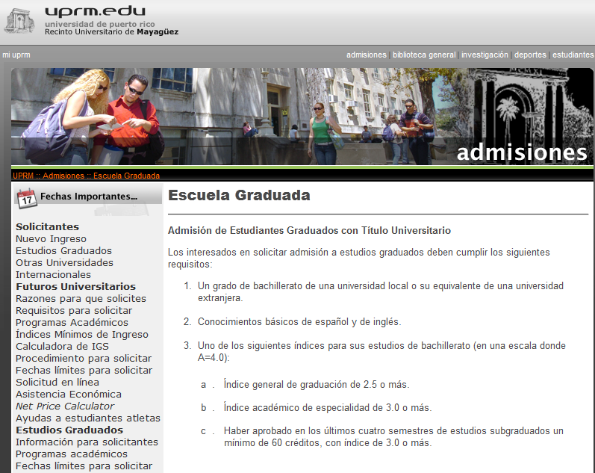
Graduate School at UPRM
http://www.uprm.edu/admisiones/stdgrad.html
Maestria en ECE:
30 creditos de los cuales
- 24 creditos clases
- 6 creditos tesis
En UPRM, se convalida desde el subgraduado:
Hasta dos cursos 5XXX
y hasta un curso 6XXX
Para un total de 9 creditos acreditados desde el subgraduado

Slide 3
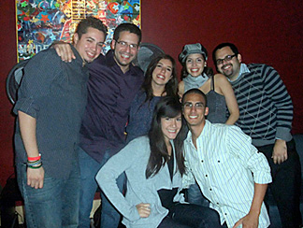
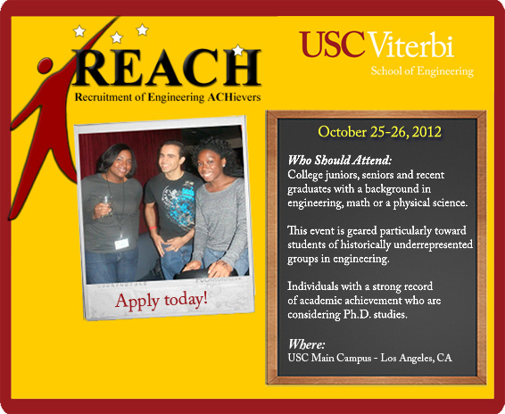
Graduate School Opportunities at USC and UC-Berkeley
http://viterbi.usc.edu/admission/phd/reach/
The Berkeley Edge Conference is designed to encourage underrepresented minority students* who are competitively eligible for our Ph.D. programs to plan to apply to UC Berkeley. Approximately thirty students are chosen from the applications submitted.
To learn more about the conference, read about:
Conference Activities
Student Eligibility
Instructions for Students and Recommenders
We will pay all travel (airfare and airport transfer to/from Oakland or San Francisco airport) and conference expenses (lodging and meals) for students accepted to the conference .
Eligibility:
Minimum overall GPA of 3.4 on a 4.0 scale
Majors in engineering, applied mathematics or physical sciences
U.S. citizenship or permanent residency
Applications are particularly encouraged from students who are Black/African Americans, Latino/Chicano Americans, Native Americans, and Pacific Islanders.
Application:
The on-line REACH application form, including a 500-word statement of intent
Two letters of reference submitted by faculty on behalf of the applicant. (Note: a third letter from a faculty, staff person, or researcher is optional)
Unofficial academic transcript.
http://ls.berkeley.edu/?q=about-college/l-s-divisions/mathematical-physical-sciences/diversity/bep/prospective-students/confer

Slide 4
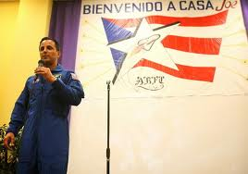
NASA Office of Education Fellowship Programs
Graduate Student Research Program (GSRP) The NASA Graduate Student Researchers Project (GSRP) is a fellowship project for graduate students who are engaged in science, technology, engineering and mathematics (STEM) studies related to NASA research and development. The goals of the project include cultivating research ties to the academic community and broadening the base of students pursuing advanced degrees in science, technology, mathematics, and engineering. Each GSRP 12 month fellowship award includes a 10 week NASA Center/HQ research experience at the Center/HQ extending the award. http://fellowships.hq.nasa.gov/gsrp/nav/
Jenkins Pre-Doctoral Fellowship Program (JPFP) JPFP is a graduate-level student support project jointly managed by NASA and the United Negro College Fund Special Programs Corporation (UNCFSP). The purpose of the Project is to increase the U.S. talent pool of women, minority and disabled persons with masters and doctoral degrees in the fields of science, technology, engineering and mathematics, and to attract these individuals to the NASA workforce pipeline. The Project provides three-year fellowship opportunities for research, mentoring and networking. http://www.uncfsp.org/spknowledge/default.aspx?page=program.view&areaid=1&contentid=177&typeid=jpfp
Astronaut Joseph Acaba

Slide 5
Energy Efficiency and Renewable Energy Science and Technology
Policy Fellowships (SunShot Initiative Fellowships)
Program Description
The Energy Efficiency and Renewable Energy (EERE) Science and Technology Policy (STP) Fellowships will serve as the next step in the educational and professional development of scientists and engineers interested in energy efficiency and renewable energy policy. The EERE STP Fellowships will provide an opportunity for scientists and engineers with relevant energy technology experience to participate in policy-related projects at DOE's Office of Energy Efficiency and Renewable Energy in Washington, D.C. The EERE STP Fellows will apply the expertise gained from their education and history of conducting research to new and ongoing EERE initiatives. As a result of their participation on this program, Fellows are expected to:
Gain deep insight into the federal government's role in the creation and implementation of policies that will affect energy technology development.
Contribute to the implementation of energy policies by applying their scientific and technical expertise to the development of solutions for problems in areas of energy efficiency and renewable energy.
Continue their education and involvement in areas that support the EERE mission either in a technical or policy-related role.
Introduce policy-related knowledge and interest into research facilities supporting the EERE mission.
Three levels of Fellowships, Fellows, Senior Fellows and Junior Fellows, will allow both recent graduates and experienced scientists and engineers to participate in the EERE STP Fellowships. All Fellows will be assigned to policy-related projects and be mentored by senior EERE staff.
Fellows selected by Solar Energy Technologies will have the additional distinction of guiding the implementation of the new solar SunShot Initiative in the DOE Solar Energy Technologies Program. The SunShot Fellows will have a key leadership role in beginning new research and development programs to achieve the goal of $1/W installed photovoltaics by 2020. The initial cohort is targeted to be 3-5 Fellows.
http://www1.eere.energy.gov/education/stp_fellowships.html#program_description
Benefits - Fellowships are for two years. Fellows will receive the following benefits during each Fellowship year:
Stipend Rates - Stipends will be based on Fellowship level and commensurate with qualifications. The stipend rate for Fellows with a Master's degree will start at $56,857, which is equivalent to the federal general schedule (GS) Grade 10 Step 1 established by the Office of Personnel Management (OPM). Fellows with a Ph.D. will receive a stipend starting at $74,872, which is equivalent to the GS Grade 12 Step 1. The stipend amount for Senior Fellows will be determined based on the number of years after receipt of the graduate degree. The stipend rates for Junior Fellows will start at $46,745, which is the equivalent to GS Grade 8, Step 1 established by OPM. The stipend rates for matriculated undergraduates will be competitive with other summer programs.

Slide 6
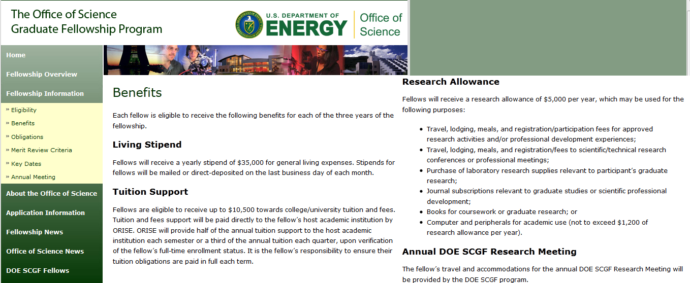
http://scgf.orau.gov/benefits.html

Slide 7
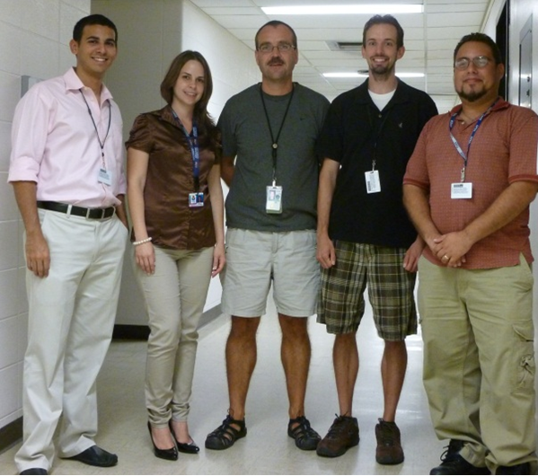
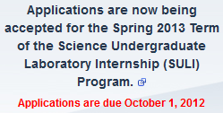
Science Undergraduate Laboratory Internships (SULI)
The Science Undergraduate Laboratory Internship (SULI) program encourages undergraduate students to pursue science, technology, engineering, and mathematics (STEM) careers by providing research experiences at the Department of Energy (DOE) National Laboratories. Selected students participate as interns appointed at one of 17 DOE National Laboratories. They perform research, under the guidance of laboratory staff scientists or engineers, on projects related to ongoing programs. DoE SULI: $425 per week (10 weeks summer term ) or (16 weeks summer term).
http://science.energy.gov/wdts/suli/
Argonne National Laboratory

Slide 8
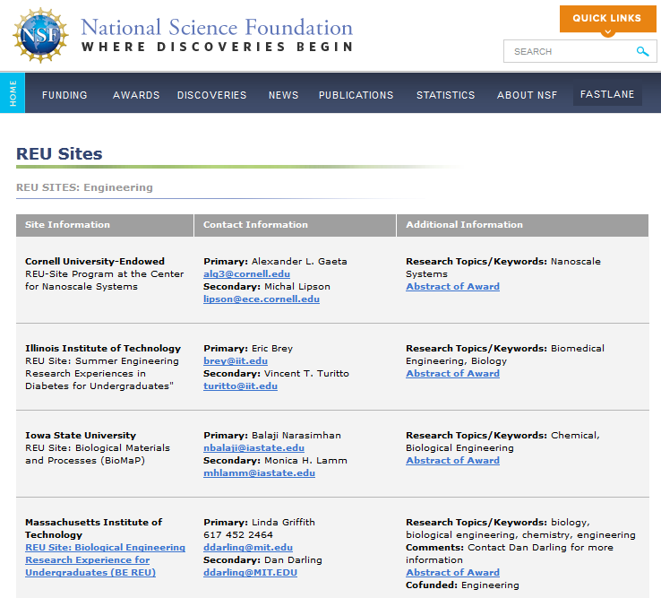
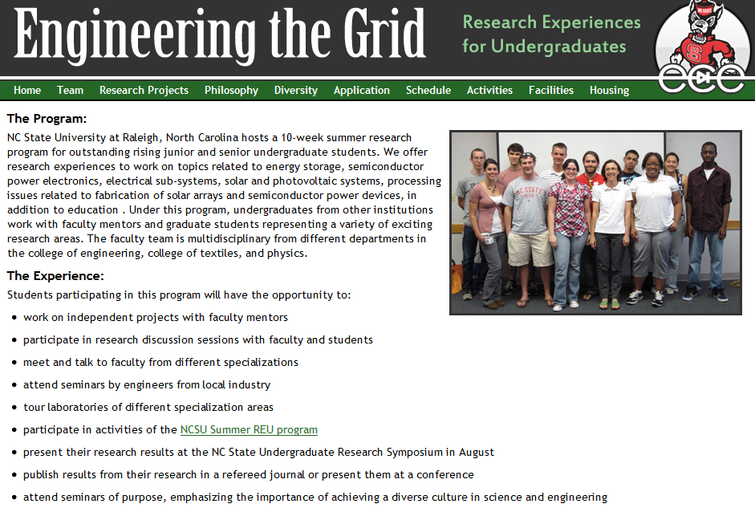
NSF-Research Experience for Undergraduate
http://www.nsf.gov/crssprgm/reu/reu_search.cfm/

Slide 9
DHS Summer Faculty and Student Research Team Program for Minority Serving Institutions
Description: The United States Department of Homeland Security (DHS) is seeking applicants for summer research appointments for faculty and student research teams from Minority Serving Institutions (MSIs). Each research team consists of one faculty and one or two students. Research is conducted during the summer at universities affiliated with DHS Centers of Excellence. At the end of the summer, faculty participants are encouraged to apply for up to $50,000 in follow-on funding. The intent of the program is to provide research opportunities to increase and enhance the scientific leadership at MSIs in research areas that support the mission and goals of DHS. In addition, the program is designed to provide faculty and students with limited DHS research experience an opportunity to understand the mission and research needs of DHS and make advances in research areas of importance to DHS, while strengthening the talent pool of scientists and engineers.
Discipline(s): life, health, and medical sciences; mathematics; computer science; physical sciences; earth, environmental, and marine sciences; social and behavioral sciences; engineering;
Additional Discipline Information: homeland security related science, technology, engineering and mathematics
Eligibility: U.S. Citizens Only. See http://www.orau.gov/dhsfaculty/ for complete eligibility requirements
Participating Universities: Eligible applicants must teach at or attend a Minority Serving Institution. Most accredited U.S. postsecondary institutions that meet the statutory criteria for identification as Minority Serving Institutions are listed at: http://www.ed.gov/about/offices/list/ocr/edlite-minorityinst.html.
Location(s): Various locations across U. S. Teams conduct research at universities affiliated with DHS Centers of Excellence.
Duration: Summer Term
Additional Duration Information: appointments are for 10 weeks
Frequency: applications are accepted each winter
Awards made: approximately 6 teams
Deadline(s): application deadline is early February
Dr. Edu B. Suarez-Martinez (pictured right) UPR-Ponce
http://www.orau.gov/dhsfaculty/

Slide 10
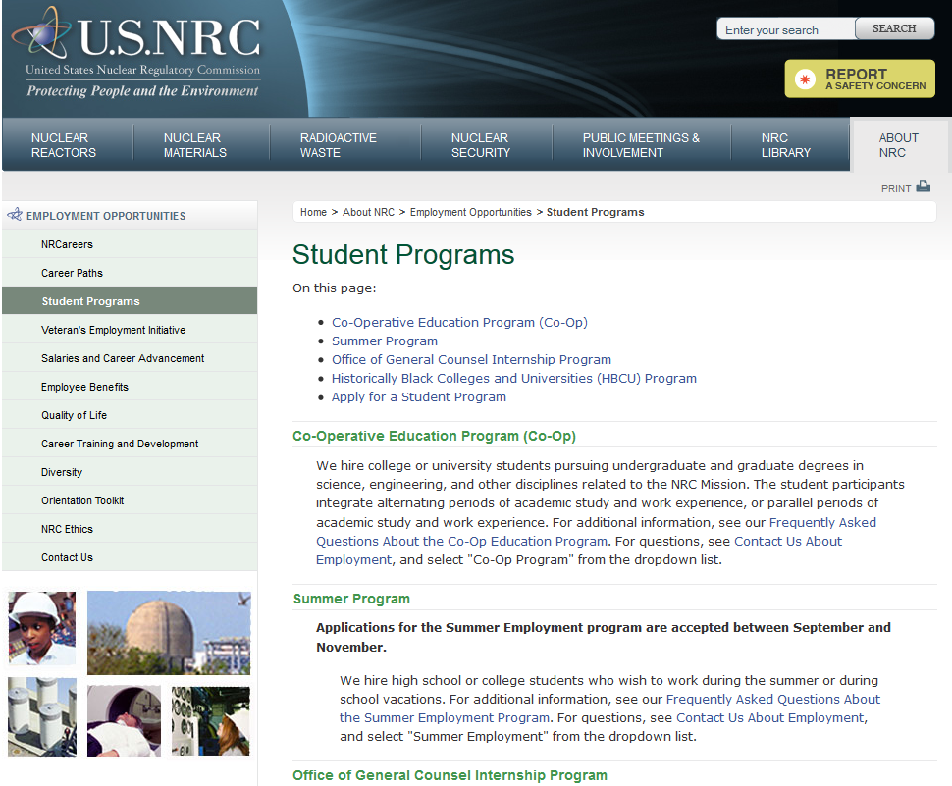
Nuclear Regulatory Commission
http://www.nrc.gov/about-nrc/employment/student-prog.html

Slide 11
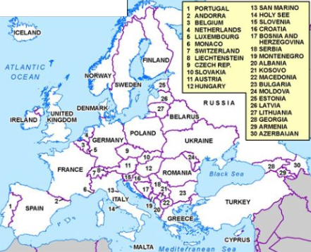
http://us.fulbrightonline.org/about/fulbright-us-student-program
What is the Fulbright U.S. Student Program
The Fulbright U.S. Student Program provides grants for individually designed study/research projects or English Teaching Assistantships. A candidate will submit a Statement of Grant Purpose defining activities to take place during one academic year in a country outside the U.S. During their grants, Fulbrighters will meet, work, live with and learn from the people of the host country, sharing daily experiences. The program facilitates cultural exchange through direct interaction on an individual basis in the classroom, field, home, and in routine tasks, allowing the grantee to gain an appreciation of others’ viewpoints and beliefs, the way they do things, and the way they think. Through engagement in the community, the individual will interact with their hosts on a one-to-one basis in an atmosphere of openness, academic integrity, and intellectual freedom, thereby promoting mutual understanding. Grant lengths and dates vary by country. Please consult the specific country summary for details.
Applicants for the Fulbright U.S. Student Program include:
Recent graduates Graduating seniors and recent Bachelor’s-degree recipients should have some undergraduate preparation and/or direct work or internship experience related to the project. Master's and doctoral candidates Graduate-level candidates must demonstrate the capacity for independent study or research, together with a general knowledge of the history, culture, and current events of the countries to which they are applying. Young professionals, including writers, creative and performing artists, journalists, and those in law, business, and other professional fields Competitive candidates who have up to 5 years of professional study and/or experience in the field in which they are applying will be considered. Those with more than 5 years of experience should apply to the Council for International Exchange of Scholars in the Fulbright Scholar Program. Competitive applicants to the Fulbright U.S. Student Program will not have recent extensive experience abroad (excluding recent undergraduate study abroad), especially in the country of application.

Slide 12
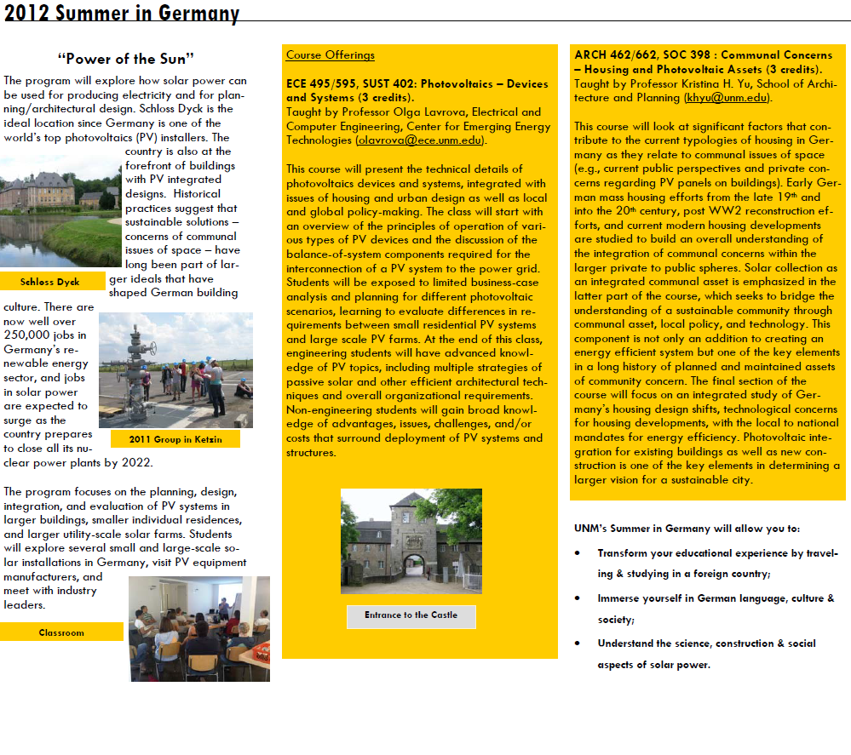
http://www.unm.edu/~isi/GermanySummerBrochure.pdf
Invest in your Education:
Consider to Study Abroad!
EIOR, Ph.D.

